Slide 1
Price comparison website
Submitted By:-
Sanyog Dani (RA2211031010087)
Arush Sirotiya (RA2211031010092)
CSE-IT V1 Section
Guided By:-
Dr. Manickam.M (Assistant Professor, CSE department)
Advanced programming practice
(21CSC203P)

Slide 2
Table of contents
Abstract
introduction
Literature Survey
Inference from the survey
Objective of the Project
Architecture diagram
Modules Description
Equations, derivation and Algorithms used
Screen shot of the project
Results and Discussions
References
Publication details

Slide 3
ABSTRACT
Price comparison sites are designed to compare the price of goods and services from a range of providers, which will help consumers in making decision to choose products that will save their money through online. Considering the customers’ busy lifestyle especially those who are living in the city area, most of the consumers prefer to buy their needs through the internet because it save their time.
They can just check it from the price comparison website itself and decide where they should buy the products they need.The best deals will be clearly highlighted. Even though not all consumers are buying online, but it is one of the ways to help consumers increase their price awareness.
Thus it is an advantage for the consumers who are always aware about the current price of a certain product so that they are not cheated by the big words advertised by the shops. Thus, with this website, the chances are open for the interested groceries shop owners to advertise their products in the website. They just need to provide the price information regularly and the admin of the website will do the rest.

Slide 4
Introduction
Nowadays, every online user looks for the best deals before buying their desired product. One of the main factors that lead to the purchase of a product is the price or cost of the product. Buyers tend to compare prices before buying a product. But since it is not that easy to search for the product on every price website, indeed there must be a solution to automate this whole process .
A web scraper is an automated program that retrieves information from various websites. This increases web traffic by up to 55% because of security issues. Price scraping or price comparison is a method that compares the prices of a product from different websites . If we use the normal technique for price comparison of 21% of ecommerce traffic then we came to implement some techniques. This website dynamically there no cost adjustment issues this model achieves an overall accuracy of 78% for price comparison we have used 100 categories from Amazon and Flipkart we have obtained a precision of 96%.

Slide 5
Introduction
This website helps to compare the prices from different E-commerce websites. This website is very useful for online shoppers who shop frequently, to check the prices of various online stores in one place . This system gives you the prices of products from various sellers to show you where to buy the product for an affordable price. Once the prices from the websites are loaded, they will be displayed on the website in the form of a price comparison.
E-commerce applications have different parts, for example, a database server, a web application server, and the PGI for transactions online. The internet has changed the way many people and organizations think and work .
For this review, a shrewd item search framework was fostered that empowers PCSs to help amateur customers explicitly by obliging client-characterized cost ranges. In this, a “beginner customer” is characterized as a web-based customer who is keen on a specific item classification and wishes to make a buy inside an estimated financial plan, but who is experiencing issues choosing a particular item attributable to an absence of earlier information on the objective item class.
Automated e-commerce creates new economic values by making business processes easier and also by opening possibilities for market interactions. These technologies provide e-commerce sellers with unprecedented opportunities to price discriminate. We show that this can be good for consumers and that the focus of regulations should not be on disallowing such practices .

Slide 6
Objective of the Project
The Objective of the Price Comparison Website Project is to Create an open source software to avoid advertisement , fake and scam websites and get the "best real time price" for genuine and good quality products from a website.

Slide 7
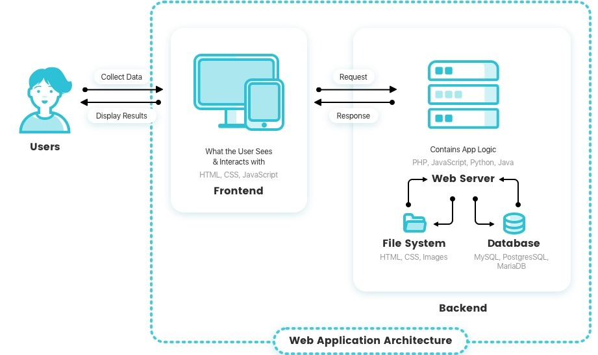
Architecture diagram

Slide 8
Modules Description
Requests
The requests module allows you to send HTTP requests using Python. The HTTP request returns a Response Object with all the response data (content, encoding, status, etc).
2. Beautiful Soup
Beautiful Soup is a Python package for parsing HTML and XML documents (including having malformed markup, i.e. non-closed tags, so named after tag soup). It creates a parse tree for parsed pages that can be used to extract data from HTML, which is useful for web scraping.
3. MySql Connector
MySQL Connector/Python enables Python programs to access MySQL databases, using an API that is compliant with the Python Database API Specification v2. 0 (PEP 249). For notes detailing the changes in each release of Connector/Python, see MySQL Connector/Python Release Notes.

Slide 9
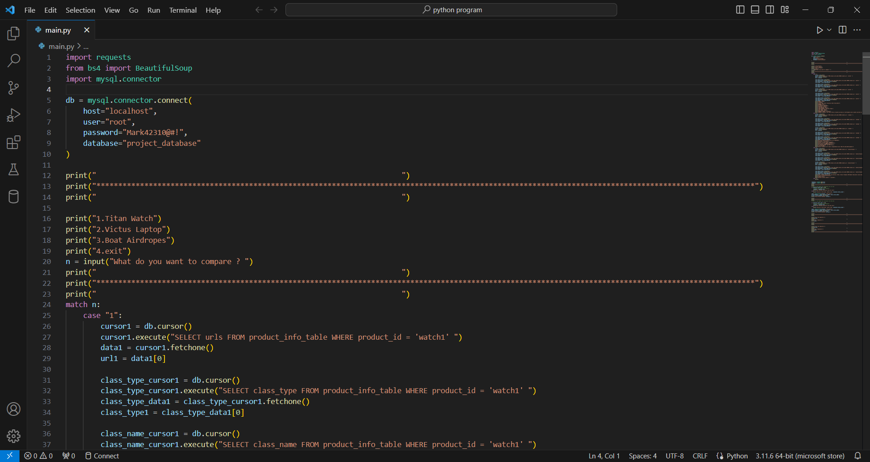
Screen shot of the project

Slide 10
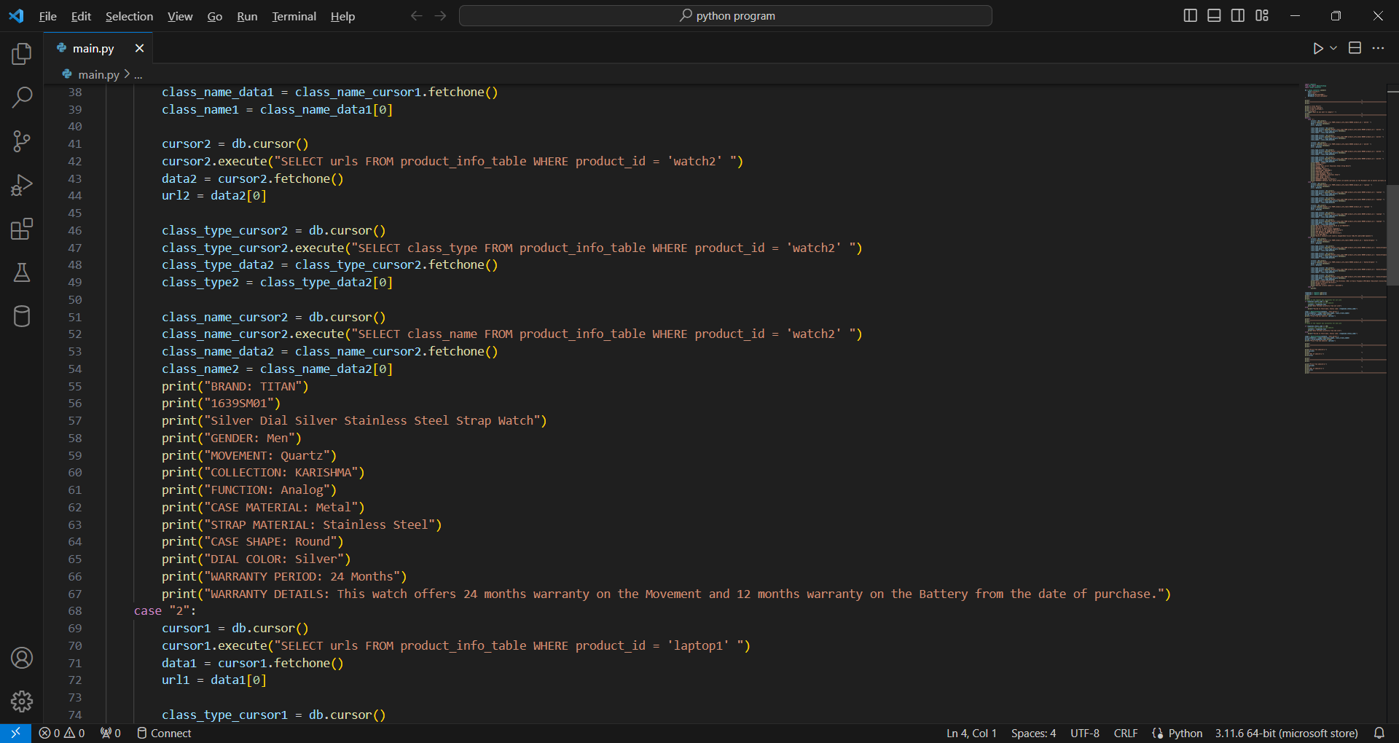
Screen shot of the project

Slide 11
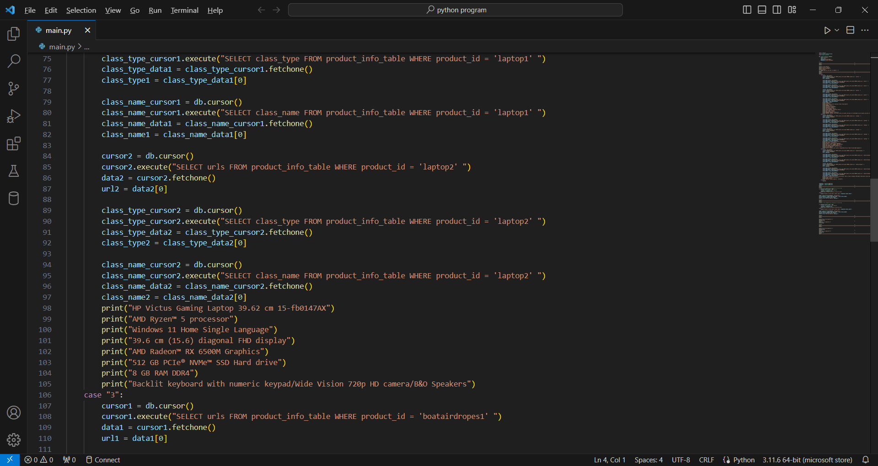
Screen shot of the project

Slide 12
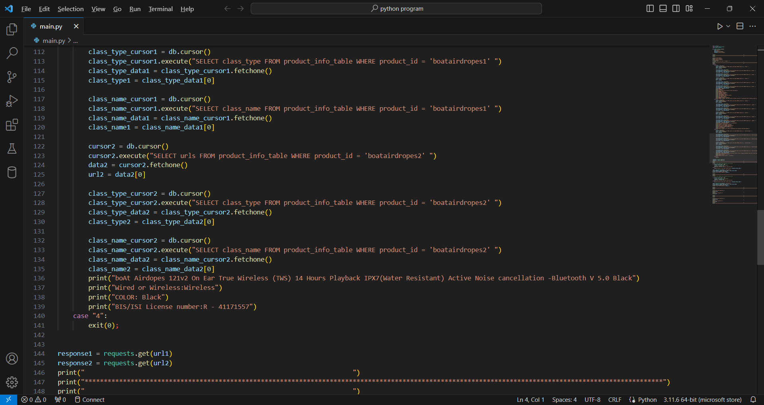
Screen shot of the project

Slide 13
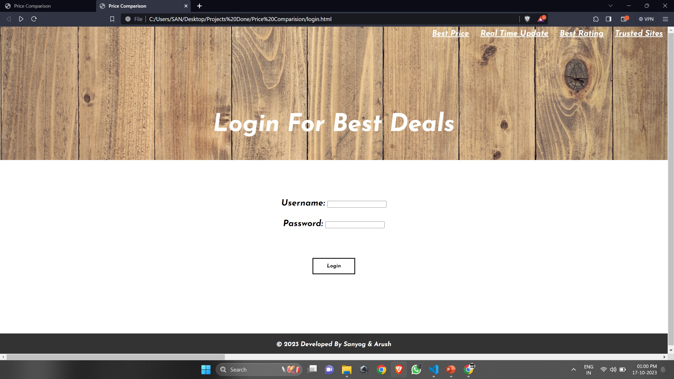
Screen shot of the project

Slide 14
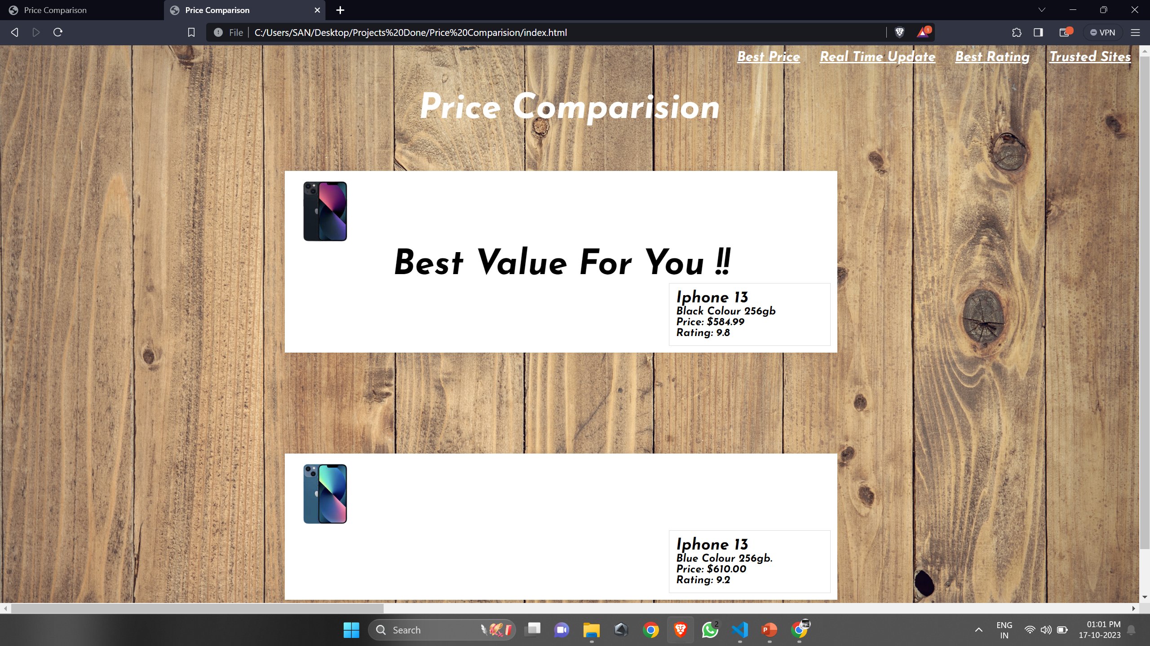
Screen shot of the project

Slide 15
References
https://dev.mysql.com
https://www.geeksforgeeks.org
https://en.wikipedia.org
https://ieeexplore.ieee.org

Slide 16
Thank YOU

